Slide 1
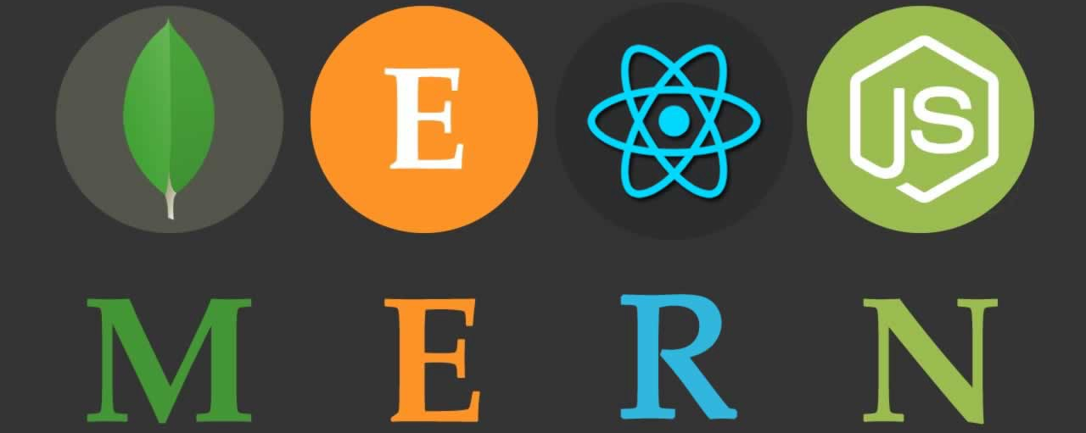
Building Web Apps Using Mern Stack

Slide 2
Pre-requisites
HTML
CSS
Java script
JSON
Callbacks – Promises and Asyncs/Await
Knowledge of database

Slide 3
Agenda
Introduction to MERN STACK
Database Concepts
Getting started with MongoDB Atlas
Getting to know NodeJS
Creating backend for Task-Manager App
React Introduction
Creating frontend for Task-Manager App
Connecting backend with frontend

Slide 4
Unfolding Mern Stack…
MERN stack is a web development framework.
MongoDB: A document-oriented, No-SQL database used to store the application data.
NodeJS: The JavaScript runtime environment. It is used to run JavaScript on a machine rather than in a browser.
ExpressJS: A framework layered on top of NodeJS, used to build the backend of a site using NodeJS functions and structures. Since NodeJS was not developed to make websites but rather run JavaScript on a machine, ExpressJS was developed.
ReactJS: A library created by Facebook. It is used to build UI components that create the user interface of the single page web application.

Slide 5
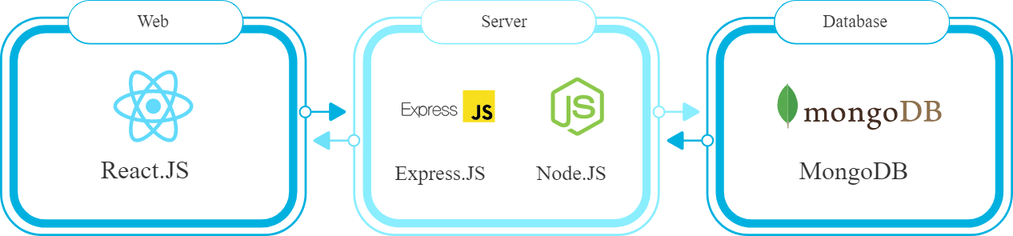
MERN STACK ARCHITECTURE

Slide 6
MONGO DB
Open-Source document oriented database
It stores data in JSON format.
Documents contain key-value pairs
Schema less
Highly Scalable
MongoDB is written in C++
NoSql Database used for high-volume data storage
Can be easily used with NodeJS
Mongo uses BSON storage format as well as to query the database

Slide 7
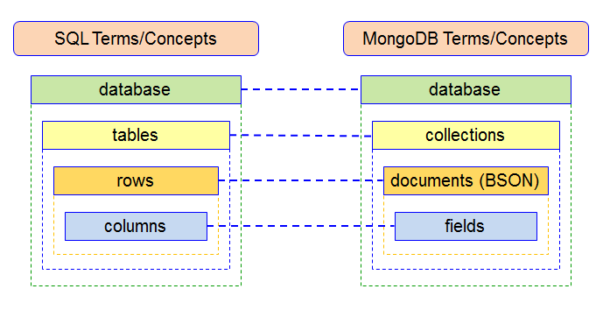
Database Concepts

Slide 8
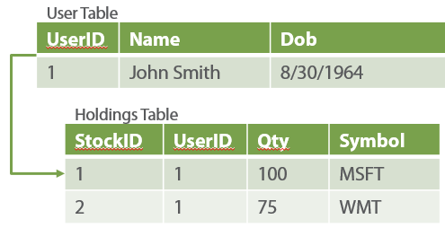
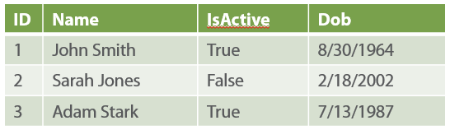
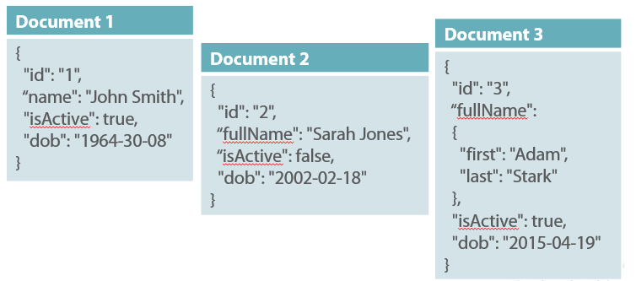
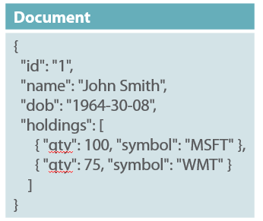
Document Based Architecture

Slide 9
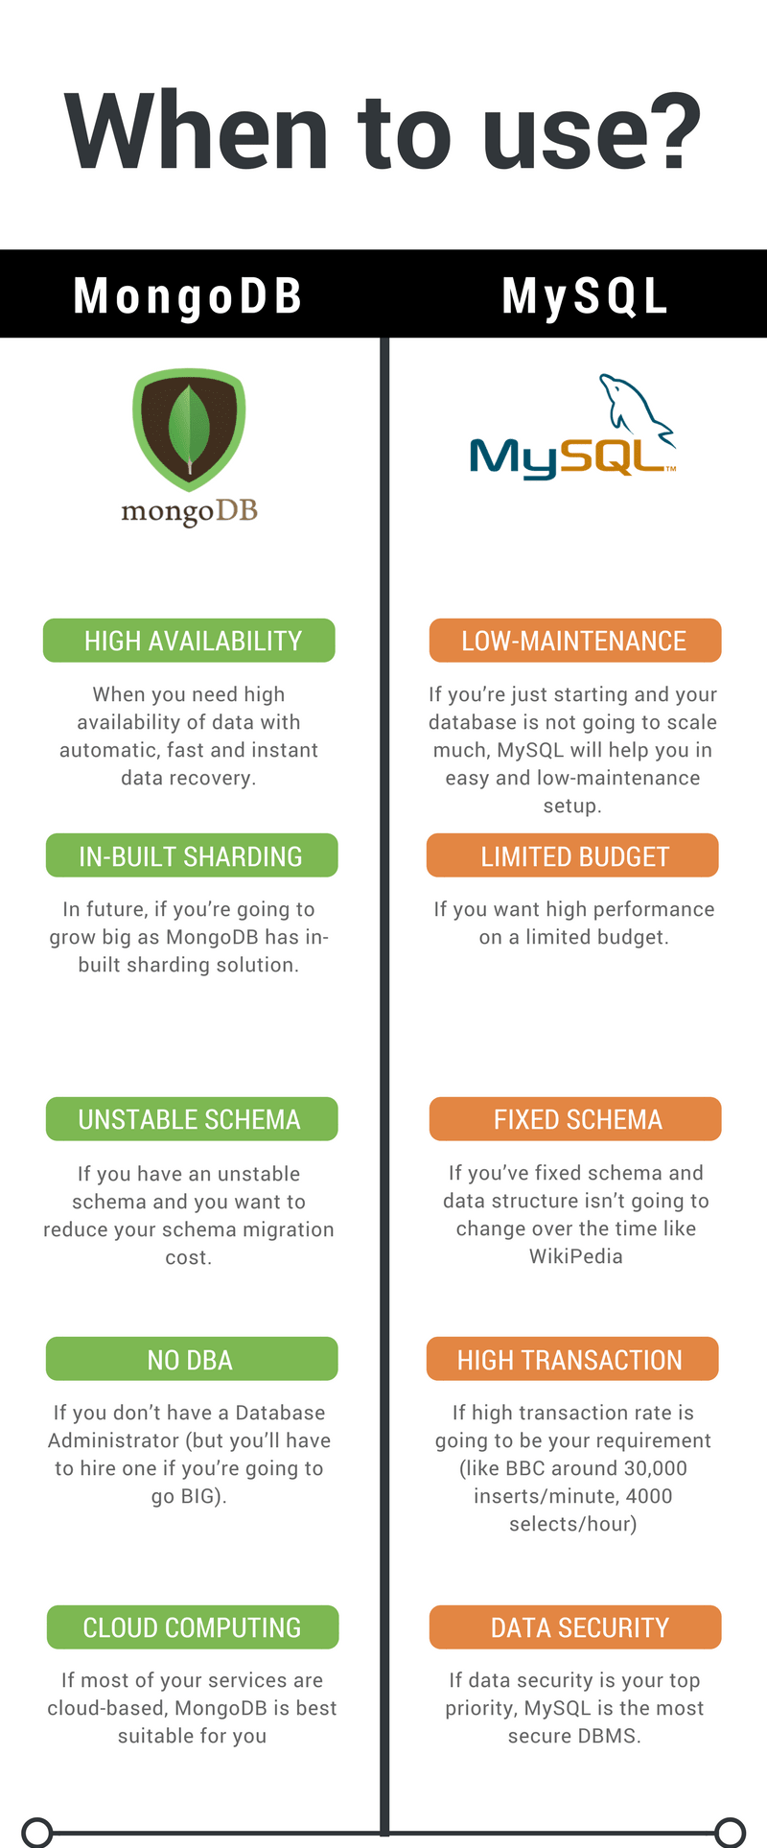
MySql vs MongoDB

Slide 10
Lets get started with MongoDB
Login MongoDB Atlas
Create an account
Create a cluster
Create a collection
Install MongoDB Shell – a mongo client.
CRUD operations
Load Sample Data
Practice

Slide 11
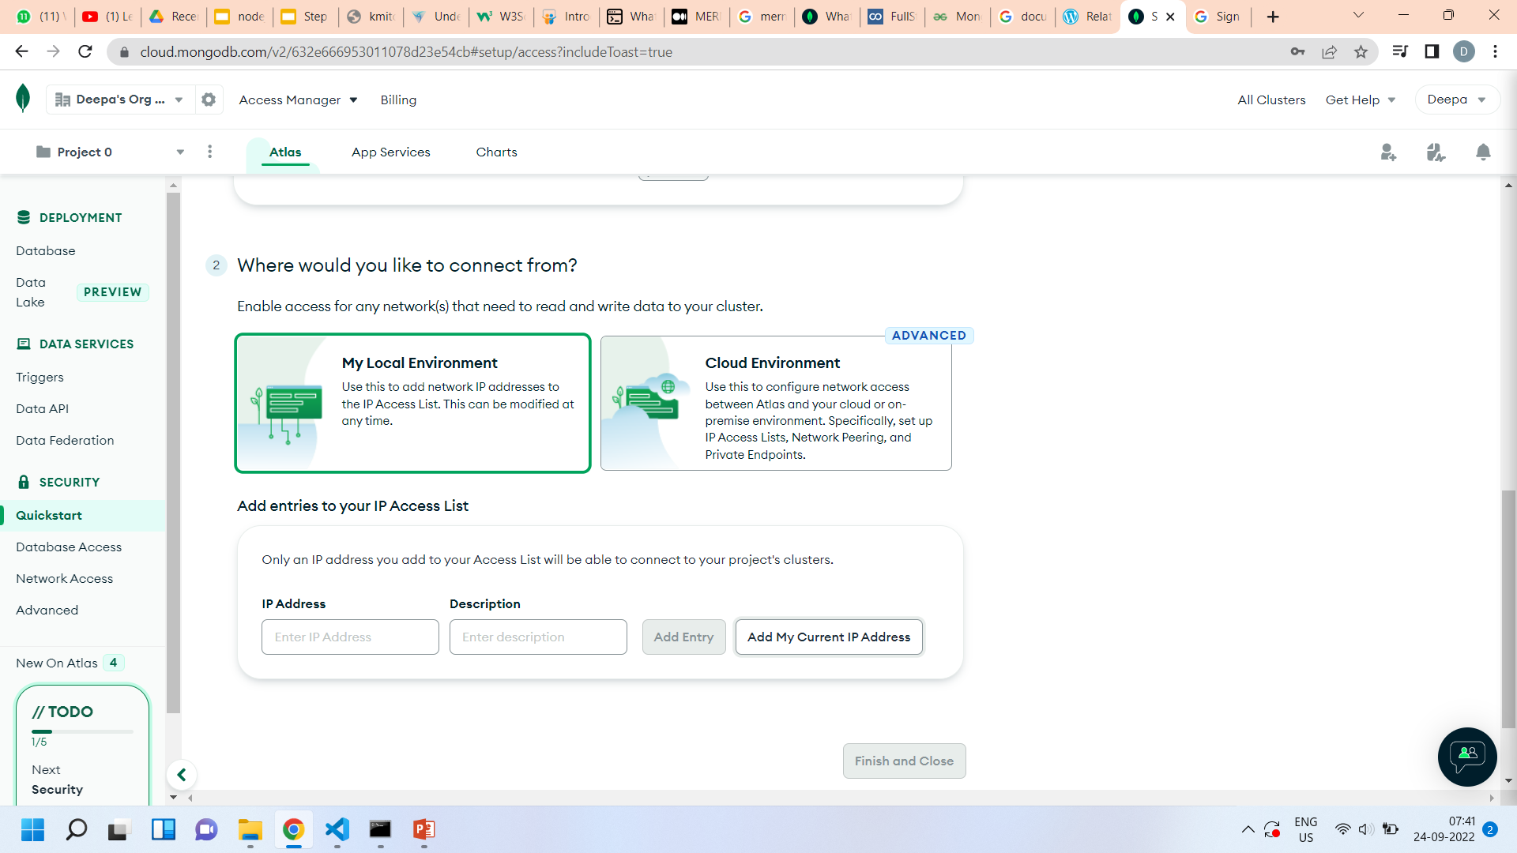
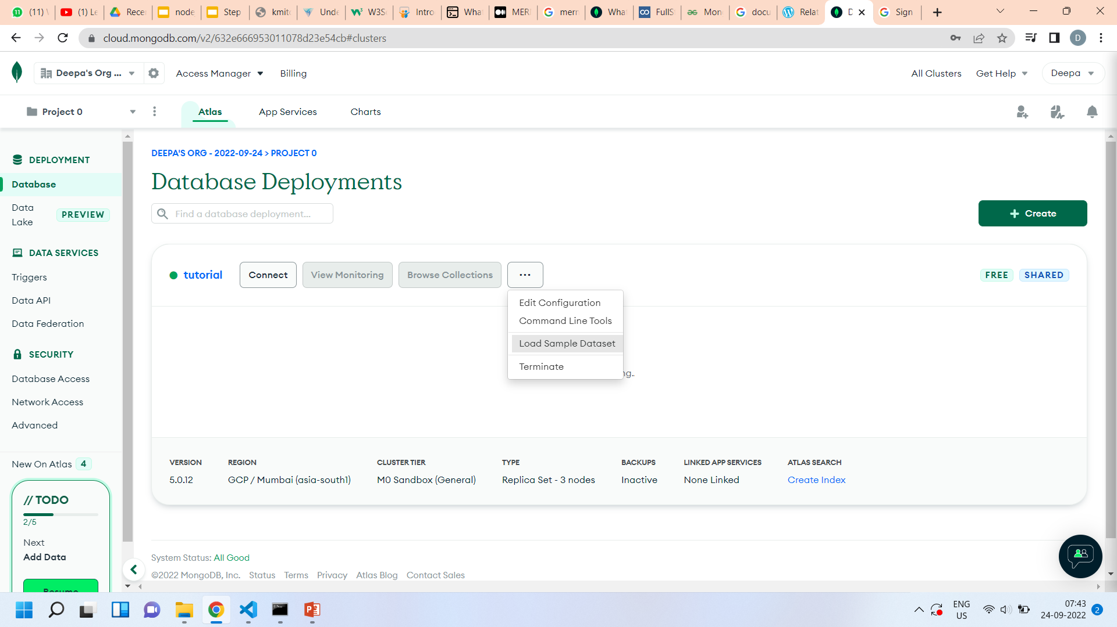
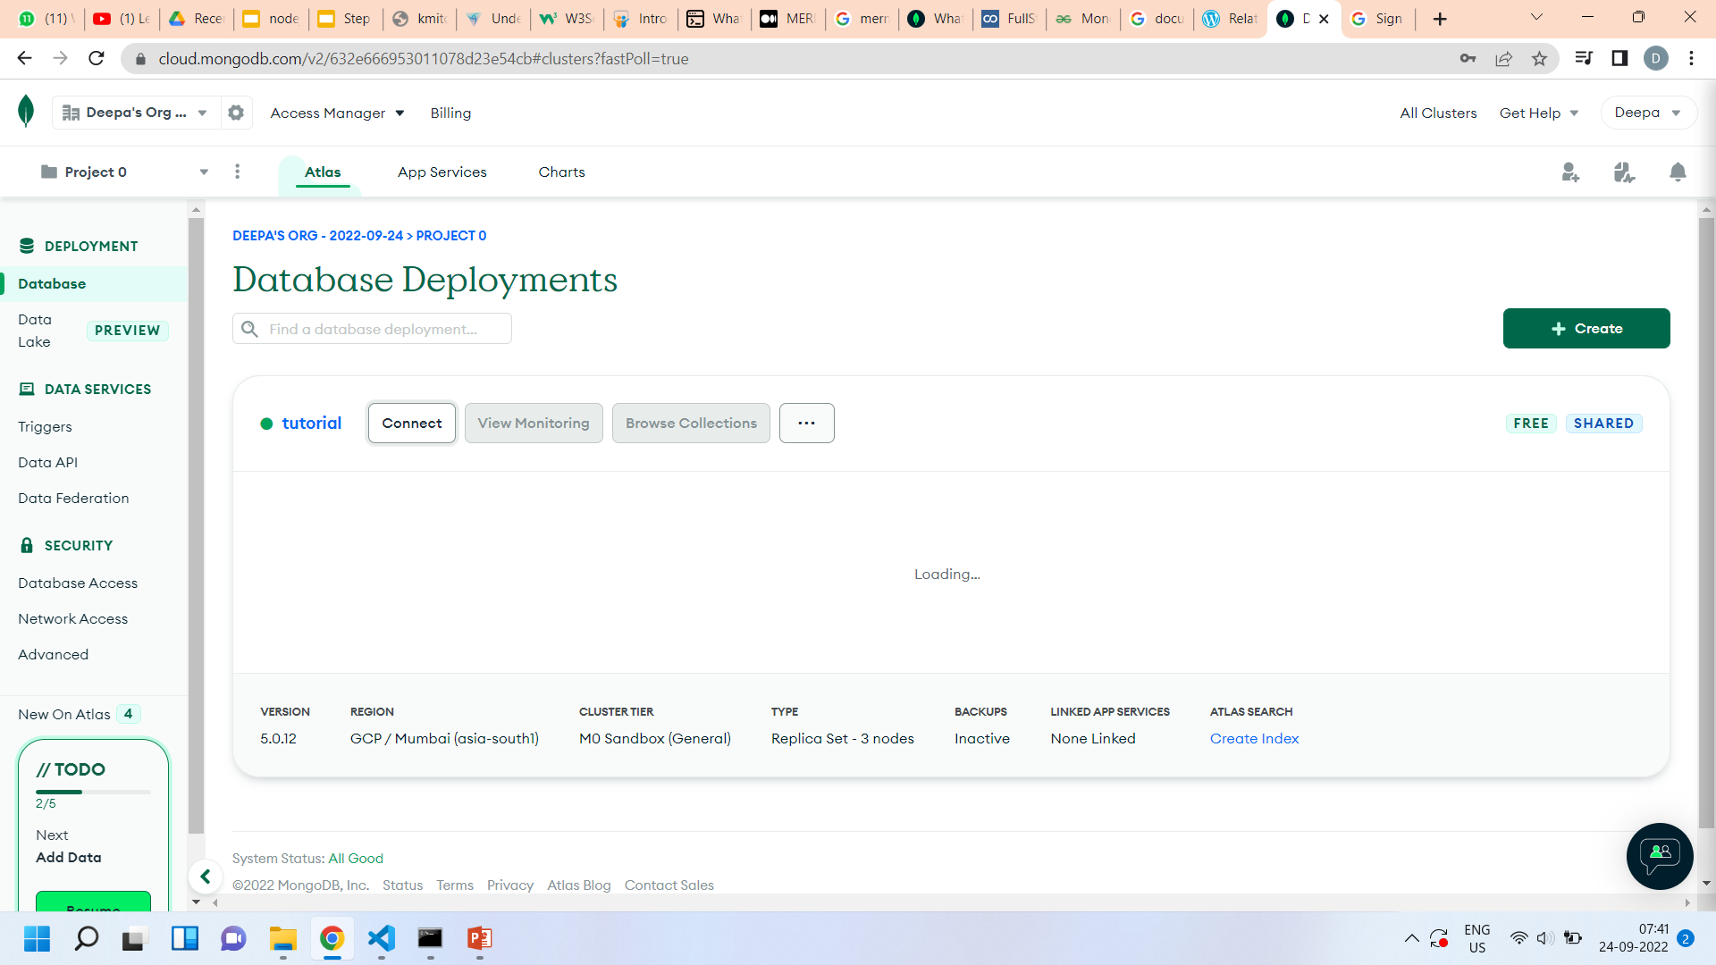
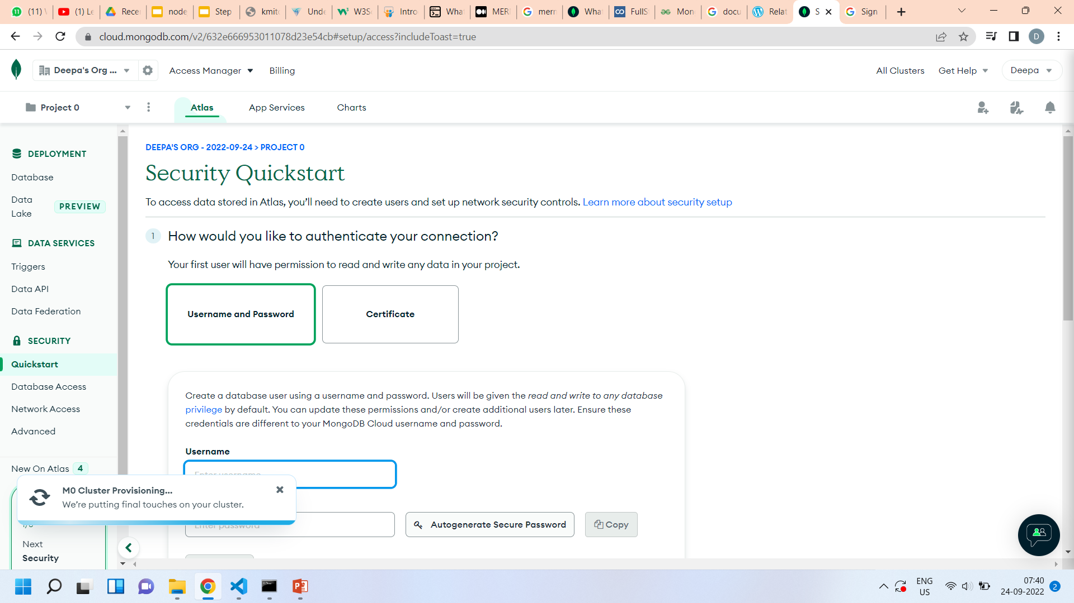
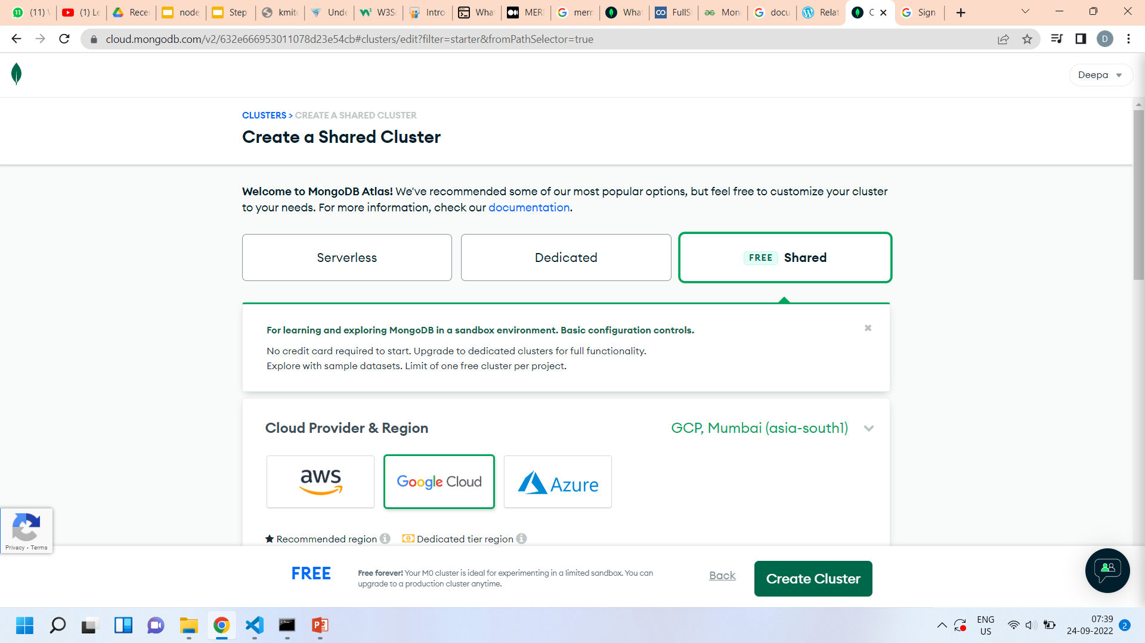
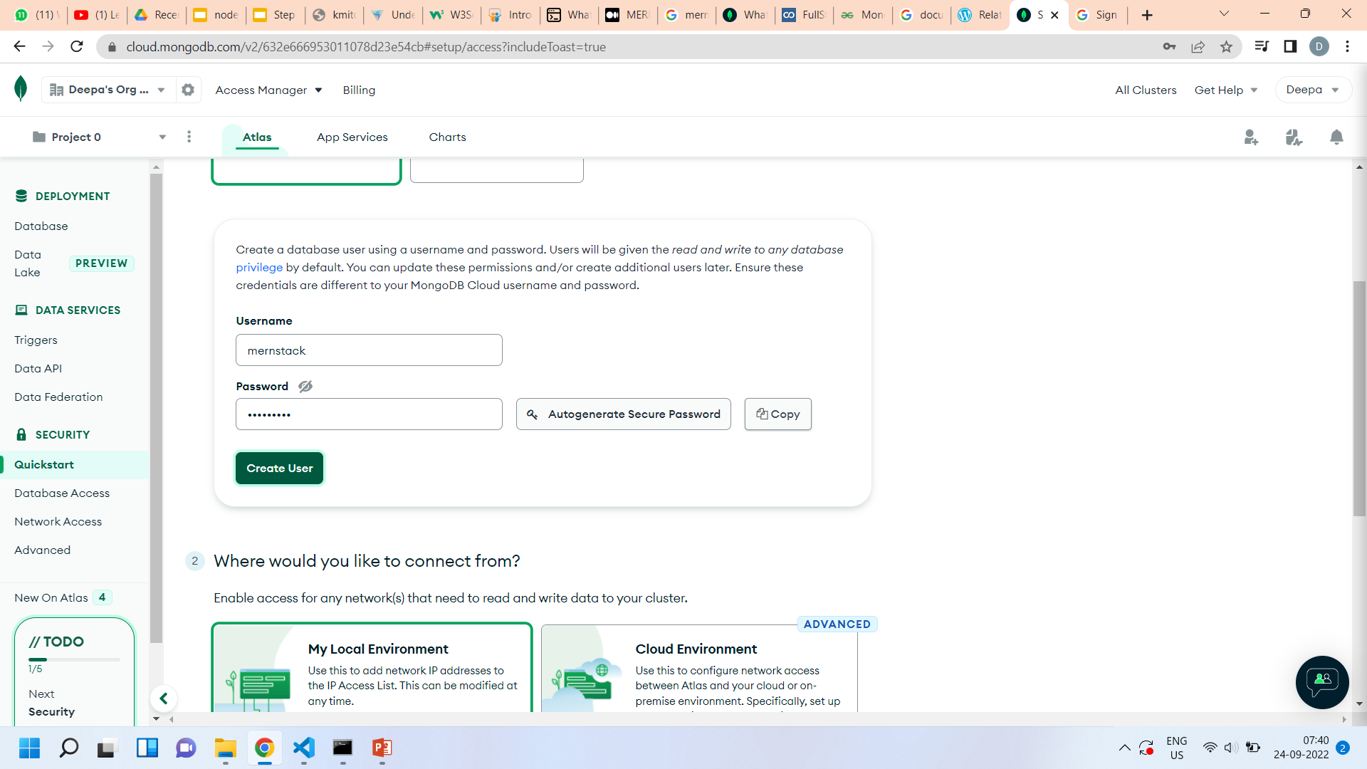
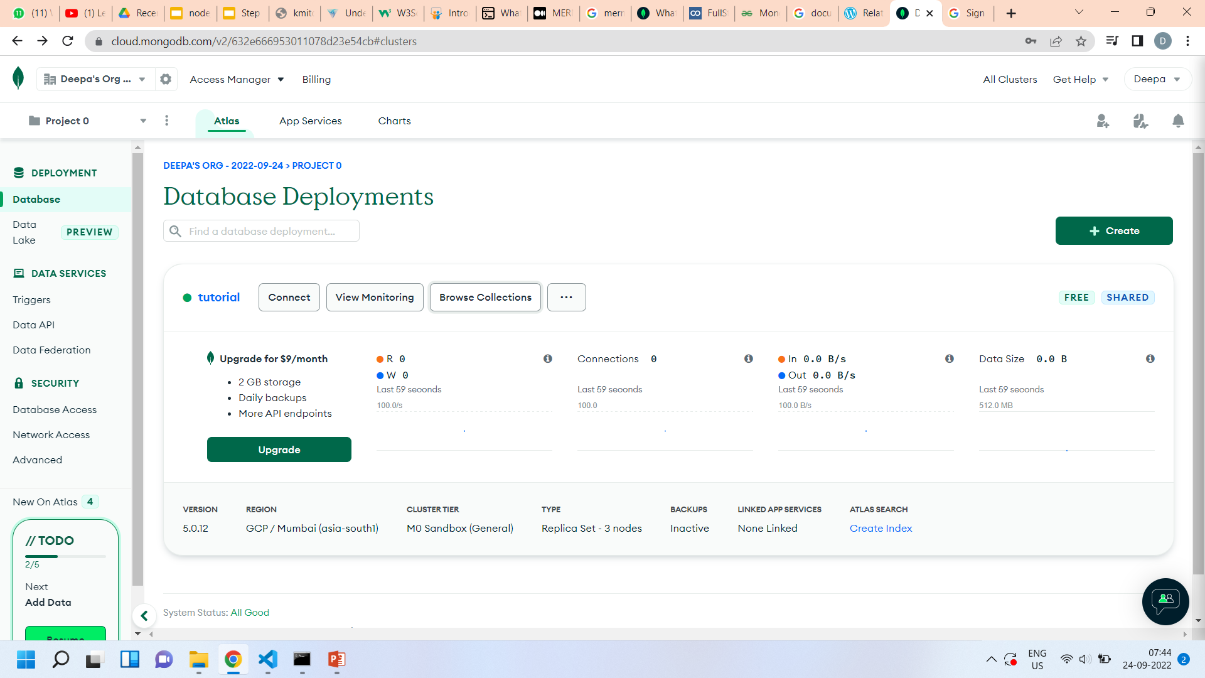
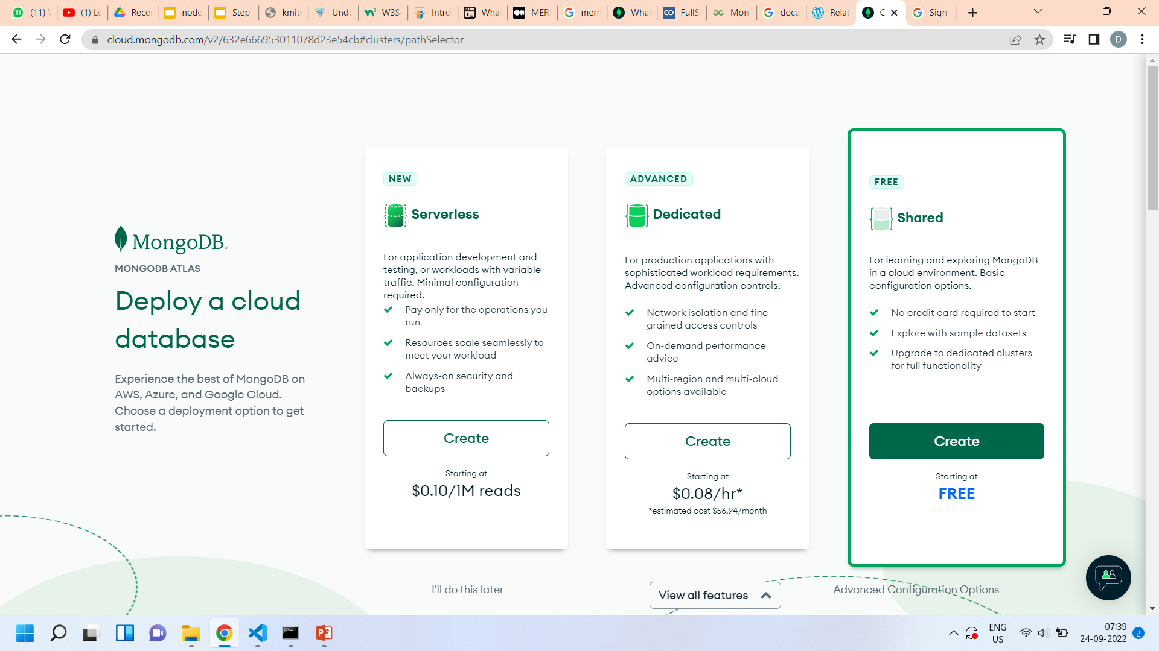
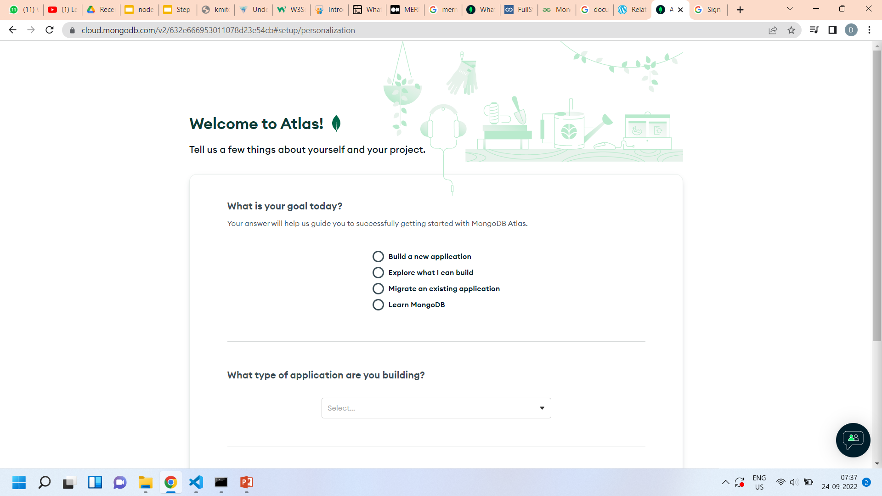
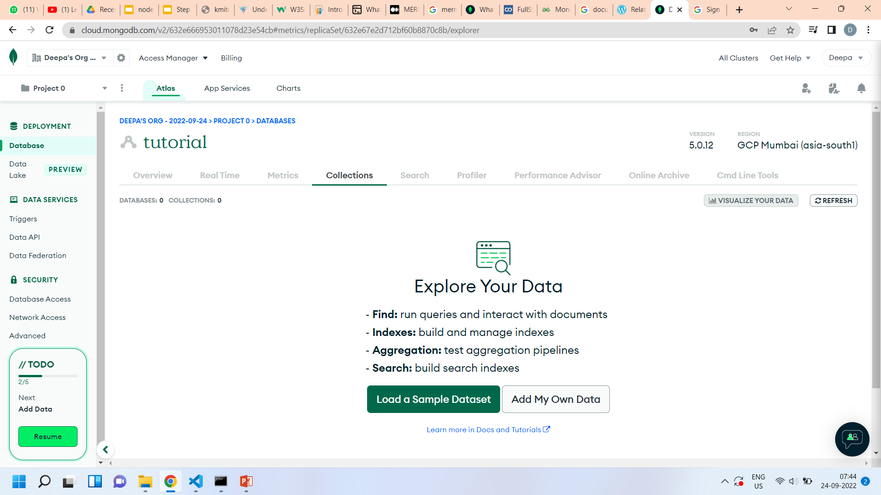
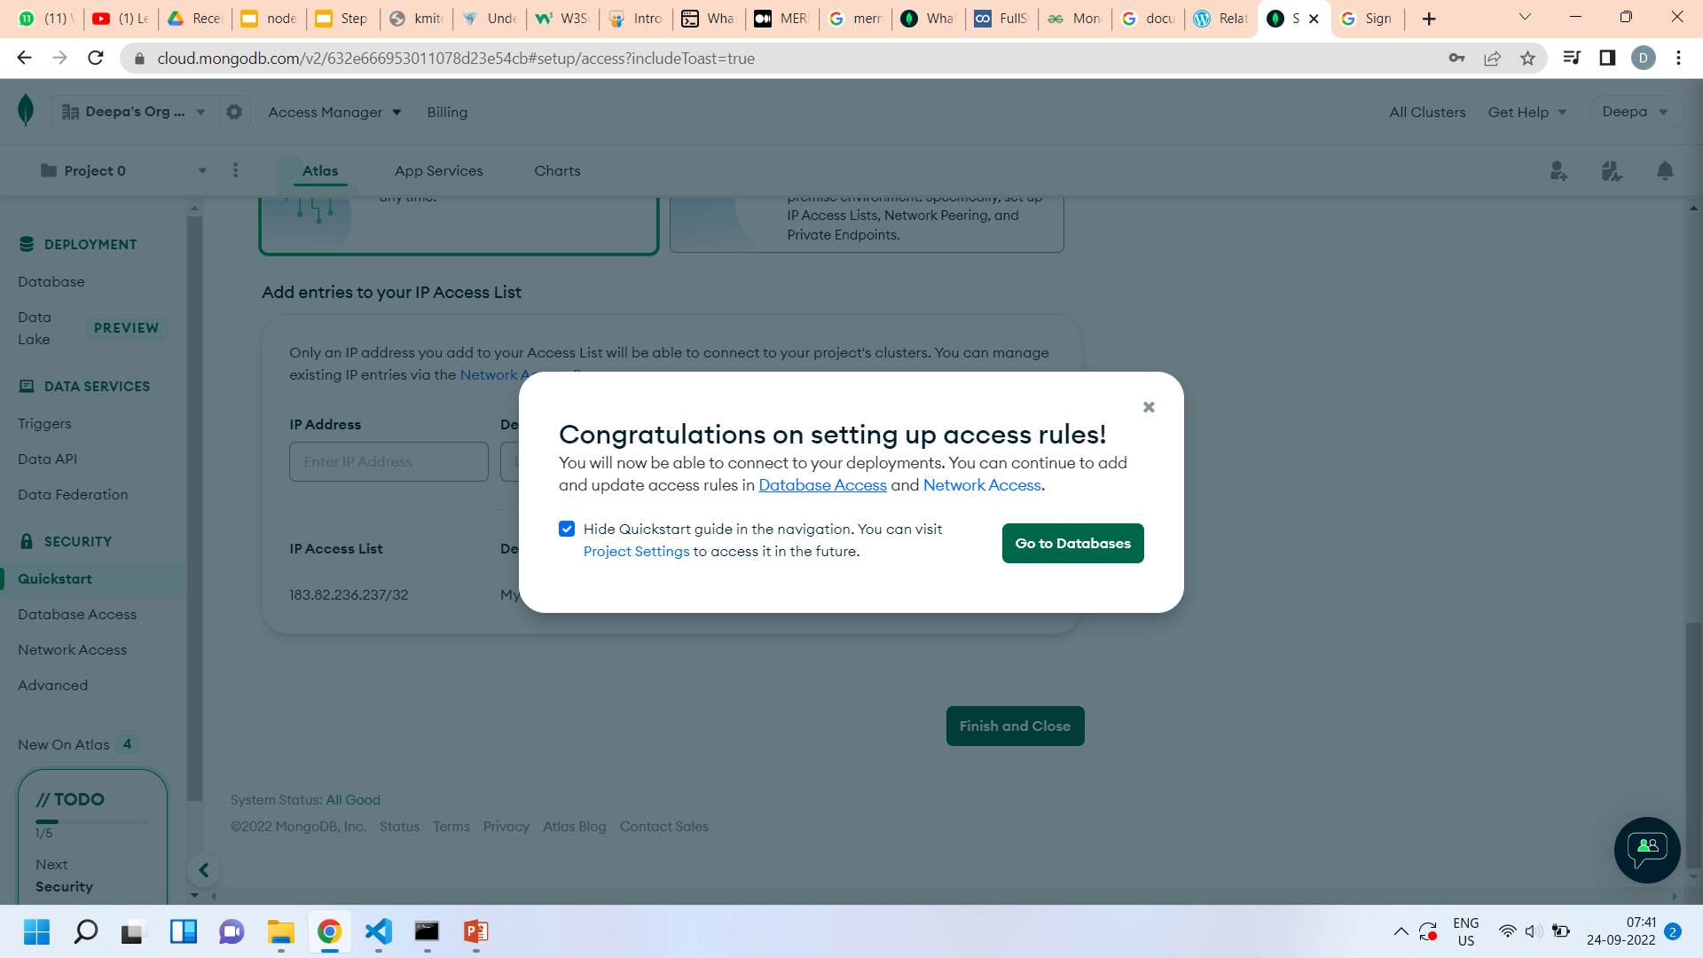

Slide 12
NodeJS saga…
JavaScript runtime environment build on Chrome’s v8 engine
It is free , open source and written in C++
NodeJS runs single-threaded, non-blocking, asynchronous programming, which is very memory effiecient.
Used to build Backend Services such as API’s
I/O bound applications , Single Page applications
Not suitable for CPU-intensive apps.

Slide 13
NODE JS – runtime environment for javascript at server
Browser
Server
DOM
Window
Interactive Apps
No Filesystem
Fragmentation
No DOM
No Window , History , etc
Server Side Apps
Filesystem, OS , Database,etc
Versions

Slide 14
Lets begin the journey
Install VSCode
Install NodeJS
Unfold nodejs
Use OS module
Use FS module
Use async and await

Slide 15
Project Structure
Install
Before you start, you need to install a few dependencies on your computer:
Express Middleware
Install the first 3 middlewares to run your App:
Express: an essential framework for NodeJS to start a server project.
esm: This goes with babel, which you will install later, and allows you to run ES6 (New version of Javascript).
nodemon: This is my favorite; it will enable you to restart the server automatically whenever you make changes in the server.
Now, your package.json will look something like

Slide 16
Package.json
{ "name": "tutorial", "version": "1.0.0", "description": "mern stack basics", "main": "app.js", "scripts": { "start": "node app.js", "test": "echo \"Error: no test specified\" && exit 1" }, "author": "", "license": "ISC", "devDependencies": { "nodemon": "^2.0.19" }, "dependencies": { "node-fetch": "2.0" }}

